Slide 1


Optimization Methods for Track Fitting in the AT-TPC
Christina Chen
Davidson College
5/2/2019

Slide 2

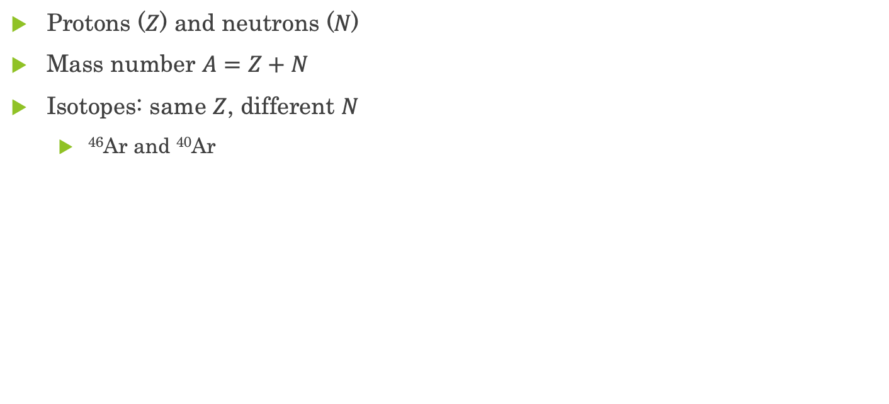
The Atomic Nucleus
neutron
proton
Protons ($Z$) and neutrons ($N$)
Mass number $A=Z+N$
Isotopes: same $Z$, different $N$
⁴⁶Ar and ⁴⁰Ar
⁴⁶Ar nucleus
Image: Jack Taylor ‘18
Notes:
The physical properties of nuclei are indicated by their number of protons
The mass number, A=Z+N, describes the number of nucleons in a nucleus.
Argon-40 and Argon-46 both have Z=18; however Ar40 has N=22 and Ar46 has N=28

Slide 3
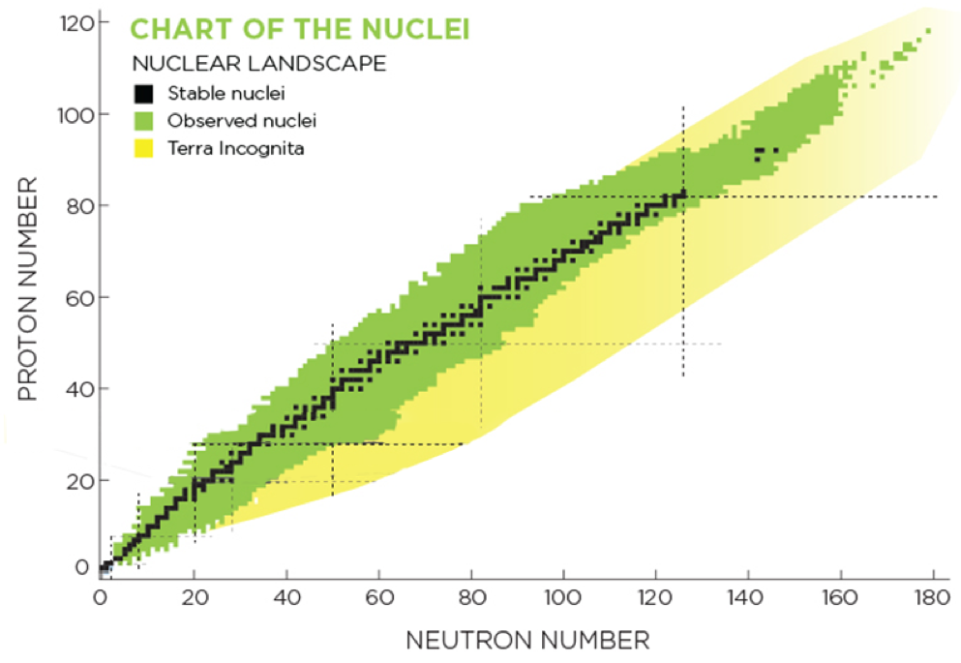
Rare Isotopes
What are they?
Stable vs. unstable
Observed vs. unknown
Proton and neutron drip line
Why do we want to study neutron-rich nuclei?
Image: Erin O’Donnell
Notes:
Rare isotopes are characterized as nuclei that deviate far from the stable isotopes for a given element.
Of more than 3000 observed isotopes, only 253 are stable isotopes, indicated by the color black on the chart.
The nuclei become increasingly unstable as they deviate farther away from the stable line
We have been able to produce proton-rich isotopes on the borderline of existence up to Z=90, but we have only explored the neutron-rich side for up to Z=8.
This is because repulsive force grows while adding protons to nuclei (because they are of the same charge), whereas the attractive nuclear force remains constant. However, adding neutrons will make the strong nuclear force grow

Slide 4
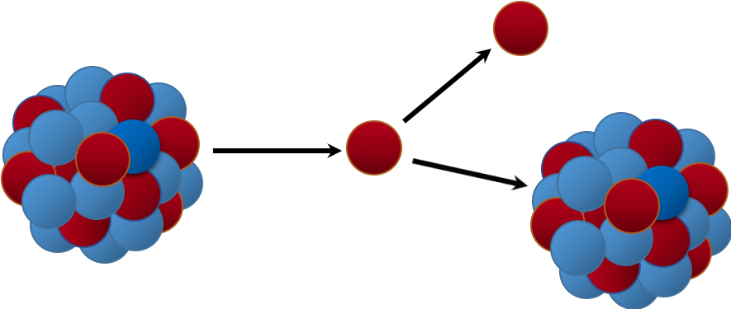
The ⁴⁶Ar-proton Scattering Experiment
⁴⁶Ar
proton
⁴⁶Ar beam → proton
Intermediate product: ⁴⁷K
Product of decay: proton
⁴⁶Ar(p,p) reaction
Image: Jack Taylor ‘18
Notes:
When protons are hit by 46Ar beams, the reaction produces an intermediate product 47K, resulting a
compound nucleus that can populate a variety of excited states.
The newly produced 47K, however, is very unstable and decays almost instantly.
In order to obtain the energy level information, we analyze the kinematics properties of the scattered proton, which is the product of the decay.

Slide 5
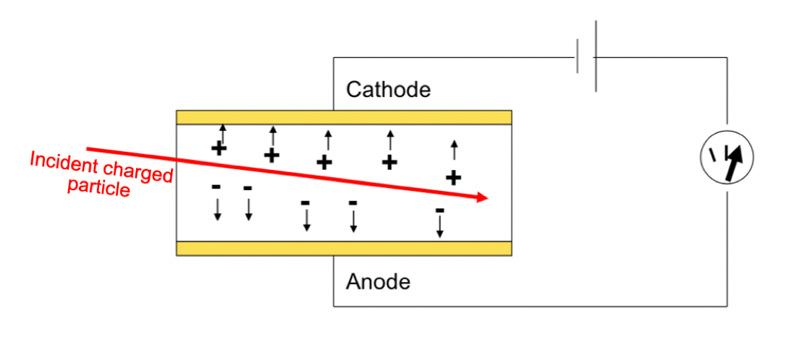
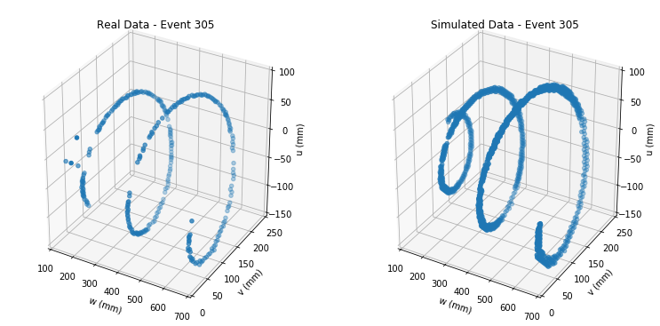

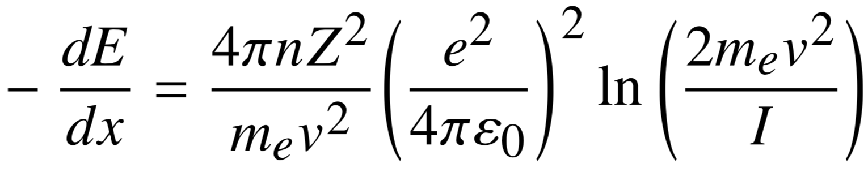
Time Projection Chamber (TPC)
E, B
Gas-filled chamber
Gas atoms are ionized by incident charged particles
Ionized electrons → anode
How do charged particles travel in the TPC?
Spiral tracks? Lorentz force!
Contracting? Energy loss!
Notes:
he charged particle ionizes the gas atoms, and the external electric field causes the ionized elections to move to the anode.
Anode has some sort of detector that captures signal
Contracting spiral tracks

Slide 6
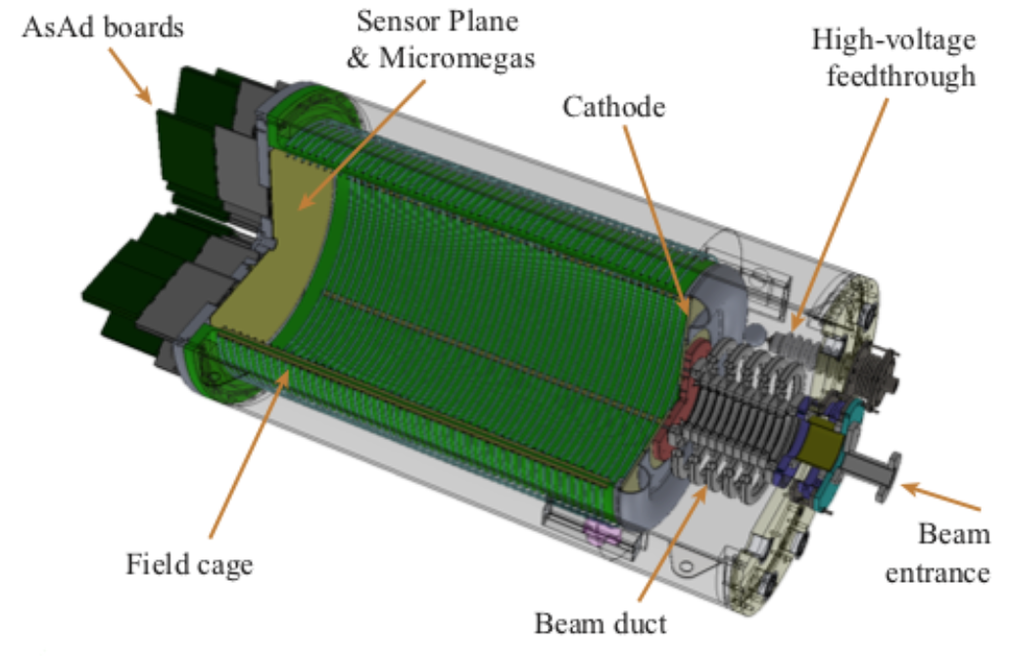
Active-Target Time Projection Chamber (AT-TPC)
Active target: gas serves as both the target and the detector
Surrounded by E-field and B-field
Pad plane on the anode side captures signals from ionized electrons
Image: Joshua Bradt
Notes:
acting as both the detector and target for the reaction
Active volume

Slide 7
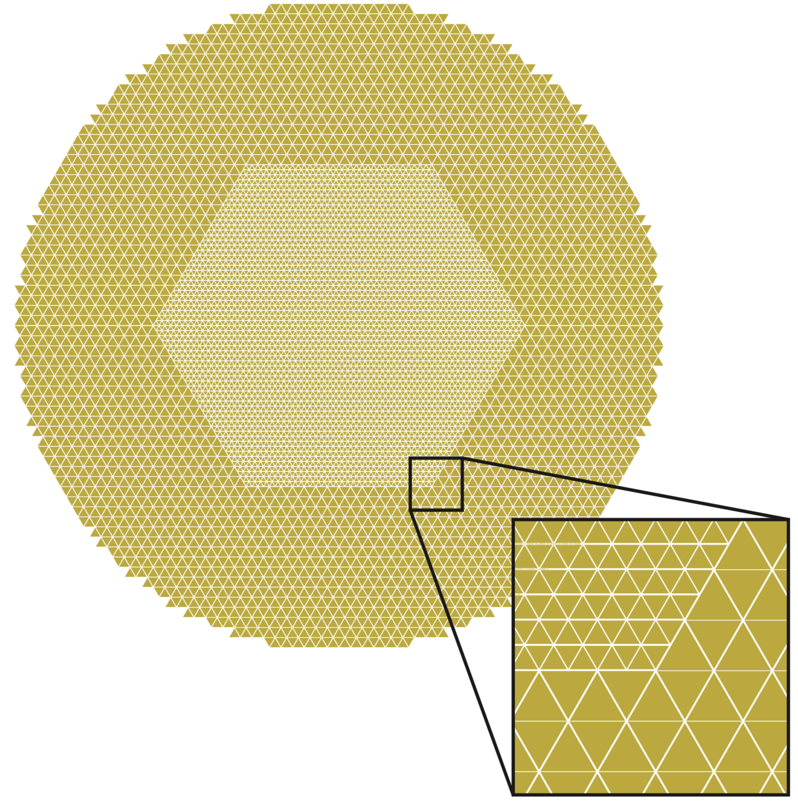
The Pad Plane
Consists of 10 240 pads
Triangular
High spatial resolution
Layout of the
pad plane
Image: Joshua Bradt
Notes:
pad plane receives charge signals as particle travels through the active volume; the large number of pads increases the spatial resolution of the detector
Smaller pads in the middle

Slide 8
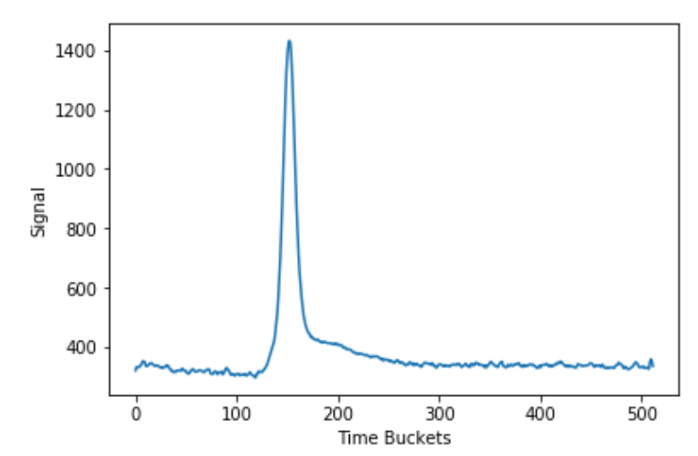
Data Analysis - Track Reconstruction
Time domain → spatial domain
(x, y) coordinates: pad location
z coordinate: directly related to time (T) when peak signal is received
T
Trace of signal received by a pad during an event
Notes:
We want to transform signal received from each pad during the experiment from time domain to spatial domain
The z coordinate is calculated from the time of which the peak signal is detected by each pad
Using the kinematics equation z = vt, where v is the electron drift velocity
In order to do this, each signal received by its corresponding pad is represented as a discrete data point in the 3-D detector coordinate system.
Assume each pad only records one peak signal during a reaction event, the time when peak amplitude occurs is directly related to the z coordinate value

Slide 9
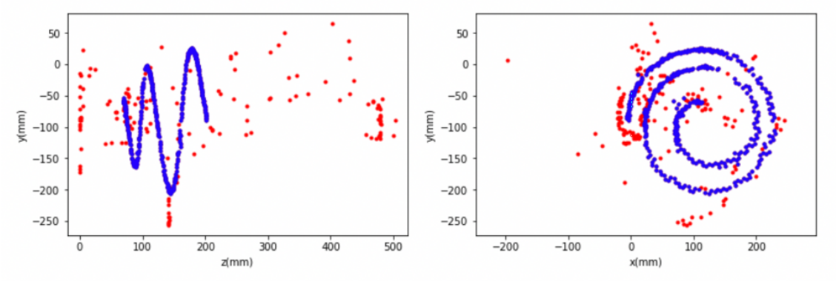
Data Analysis – Noise Removal
Random noise: nearest neighbor algorithm
Structural noise: Hough transform
Noise removal results for one event.
Red: original track
Blue: track after noise removal (cleaned track)
Notes:
Eliminate points that have fewer neighbors
Detects spirals, unravels them into several parallel lines, and eliminates the points that are farther away from the lines

Slide 10
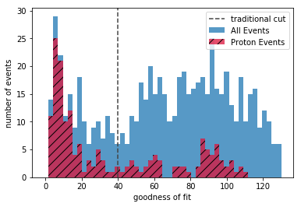
Data Analysis – Track Fitting
Extracting physical properties of scattered proton from its track
Parameter generation in 6-D search space (x, y, z, E, θ, φ)
Track simulation
Comparing simulated track with the real track → the objective function
Notes:
Small chi is better (for the table too)

Slide 11
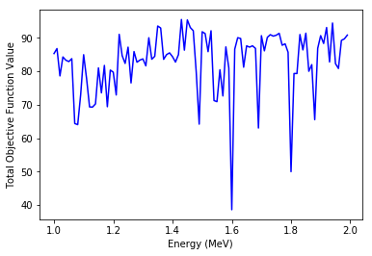
Global Optimization Methods
Global vs. local
Stochastic optimization methods
Use of random variables
Do not converge
High time efficiency
Naïve Monte Carlo
Differential evolution
Basin hopping
Total objective function value plotted across one parameter (energy)

Slide 12
Naïve Monte-Carlo Method
Notes:
Starts with a seed point that contains the kinematic parameters in an array
Random generation of uniformly distributed candidate points around the seed point
The point with lowest objective function value is updated as the new seed point
Stops when the number of iteration is reached

Slide 13
Naïve Monte-Carlo Method
Notes:
Starts with a seed point that contains the kinematic parameters in an array
Random generation of uniformly distributed candidate points around the seed point
The point with lowest objective function value is updated as the new seed point
Stops when the number of iteration is reached

Slide 14
Naïve Monte-Carlo Method
Notes:
Starts with a seed point that contains the kinematic parameters in an array
Random generation of uniformly distributed candidate points around the seed point
The point with lowest objective function value is updated as the new seed point
Stops when the number of iteration is reached

Slide 15
Naïve Monte-Carlo Method
Notes:
Starts with a seed point that contains the kinematic parameters in an array
Random generation of uniformly distributed candidate points around the seed point
The point with lowest objective function value is updated as the new seed point
during the next iteration, generate same number of candidate points but on a smaller range – in order to achieve convergence

Slide 16
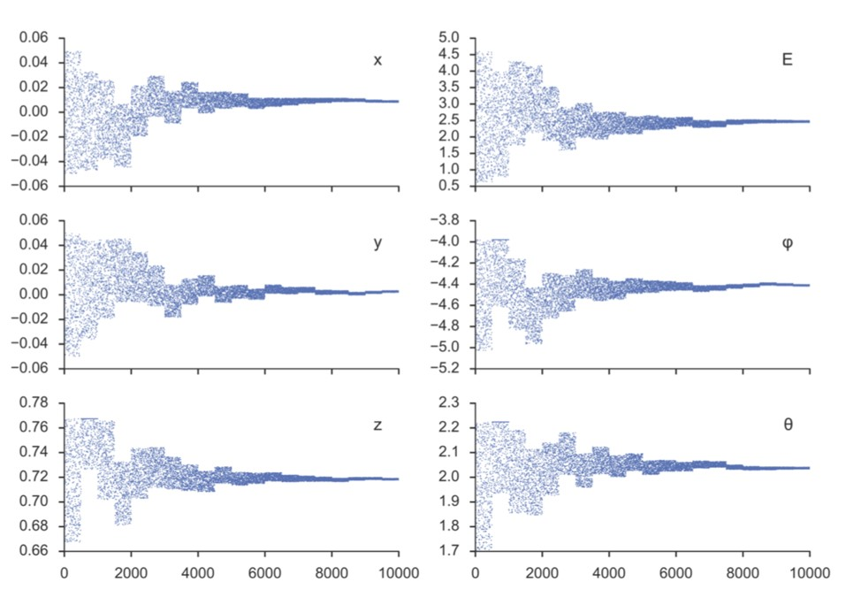
Monte Carlo search space vs. iteration number. Image: Joshua Bradt
0
4
8
12
16
20
0
4
8
12
16
20
Number of iterations

Slide 17
Differential Evolution
Notes:
Randomly selects n points within search space (population)
Recombines each point with other candidates in the population -> there are different strategies for this
Decides whether the mutated points will be kept as the new candidate
Stops when the point with lowest objective function value is found and/or when the number of iteration is reached

Slide 18
Differential Evolution – Mutation
parent
Notes:
Randomly selects n points within search space (population)
Recombines each point with other candidates in the population -> there are different strategies for this
Decides whether the mutated points will be kept as the new candidate
Stops when the point with lowest objective function value is found and/or when the number of iteration is reached

Slide 19
Differential Evolution – Mutation
parent
mutant
Notes:
mimics the genetic algorithms
Randomly selects n points within search space (population)
Recombines each point with other candidates in the population -> there are different strategies for this
Decides whether the mutated points will be kept as the new candidate
Stops when the point with lowest objective function value is found and/or when the number of iteration is reached

Slide 20
Differential Evolution – Recombination
parent
target
vector

Slide 21
Differential Evolution – Recombination
parent
child

Slide 22
Differential Evolution – Selection
child

Slide 23
Basin Hopping
f(x)
x
Notes:
Global stepping algorithm + local minimization algorithm
Calculates local minimum based on the starting point
Applies a random perturbation to the coordinates
Calculates local minimum at new location, then accepts/rejects the new candidate using Metropolis criteria
Stops when the number of iteration is reached

Slide 24
Basin Hopping
f(x)
x
Notes:
Global stepping algorithm + local minimization algorithm
Calculates local minimum based on the starting point
Applies a random perturbation to the coordinates
Calculates local minimum at new location, then accepts/rejects the new candidate using Metropolis criteria
Stops when the number of iteration is reached

Slide 25
Basin Hopping
f(x)
x
Notes:
Global stepping algorithm + local minimization algorithm
Calculates local minimum based on the starting point
Applies a random perturbation to the coordinates
Calculates local minimum at new location, then accepts/rejects the new candidate using Metropolis criteria
Stops when the number of iteration is reached

Slide 26
Local Optimization Methods for Basin Hopping
Broyden-Fletcher-Goldfarb-Shanno (BFGS) algorithm
Nelder-Mead Method
Nonlinear Conjugate Gradient Method
Powell’s Method

Slide 27
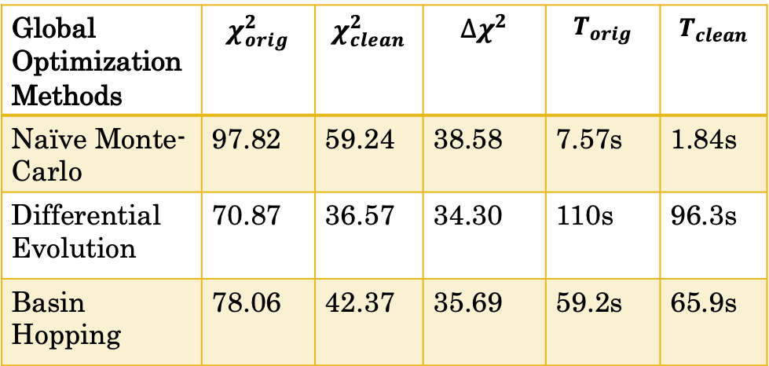
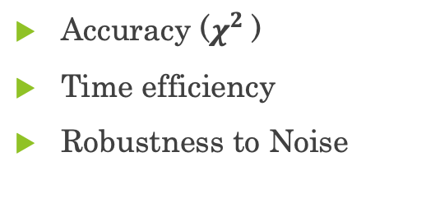
Fitting Results (7198 Events)
Global Optimization Methods | $$χ_{orig}^{2}$$ | $$χ_{clean}^{2}$$ | $$∆χ^{2}$$ | $$T_{orig}$$ | $$T_{clean}$$
Naïve Monte- Carlo | 97.82 | 59.24 | 38.58 | 7.57s | 1.84s
Differential Evolution | 70.87 | 36.57 | 34.30 | 110s | 96.3s
Basin Hopping | 78.06 | 42.37 | 35.69 | 59.2s | 65.9s
Accuracy ($χ_{}^{2}$)
Time efficiency
Robustness to Noise
Notes:
Only proton events for the first time

Slide 28
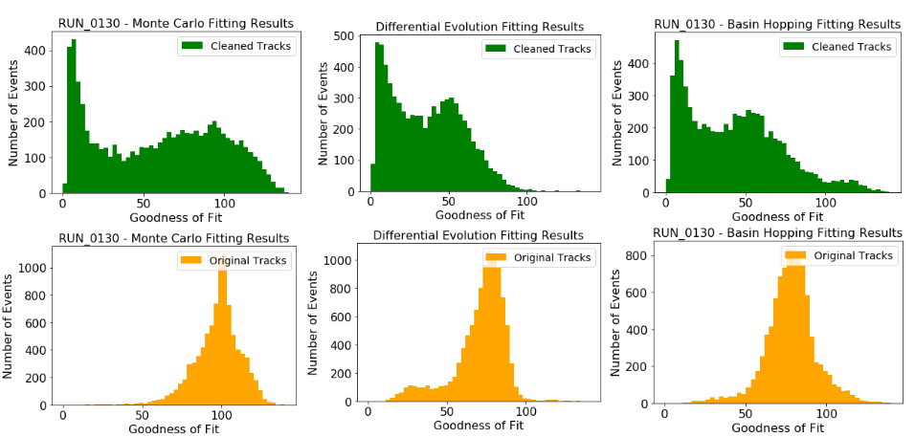
Notes:
Plot from paper (to say classification vs. fitting processes)
Two slides for the modified function
Another on the local and add detail pages on the end
Eliminate “run_0130”

Slide 29
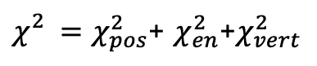
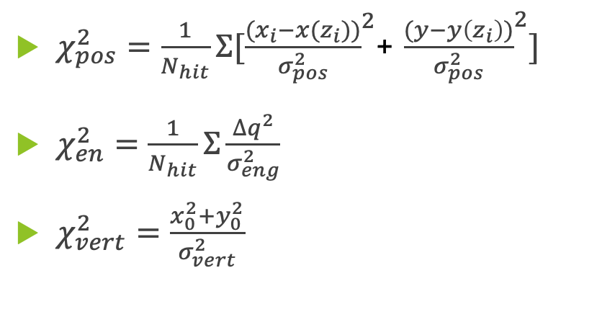
Modifying the objective function
${χ_{}^{2}=χ}_{pos}^{2}$+ $χ_{en}^{2}$+$χ_{vert}^{2}$
The original objective function
$χ_{pos}^{2}=\frac{1}{N_{hit}}Σ[{\frac{{(x}_{i}−x(z_{i}))}{σ_{pos}^{2}}}^{2}$+ ${\frac{(y−y\left(z_{i}\right))}{σ_{pos}^{2}}}^{2}]$
$χ_{en}^{2}=\frac{1}{N_{hit}}Σ{\frac{∆q^{2}}{σ_{eng}^{2}}}^{}$
$χ_{vert}^{2}=\frac{x_{0}^{2}+y_{0}^{2}}{σ_{vert}^{2}}$
Unitless?
Comparable?
Weight too high on position?

Slide 30
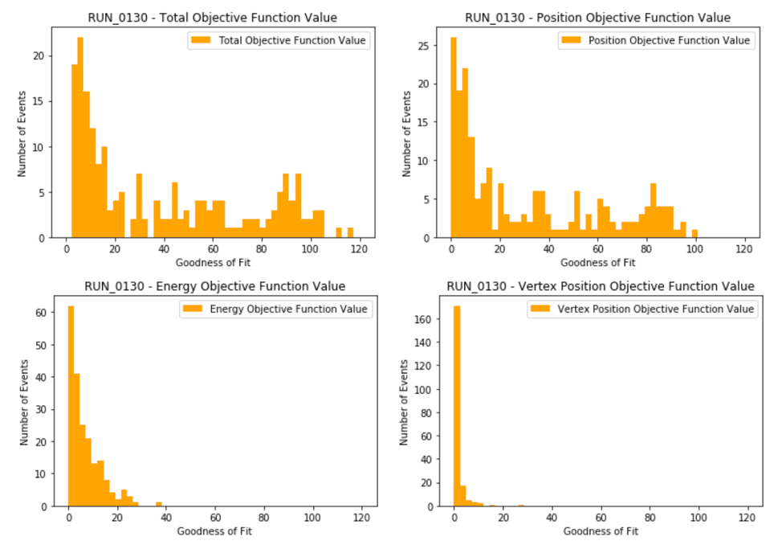

Slide 31
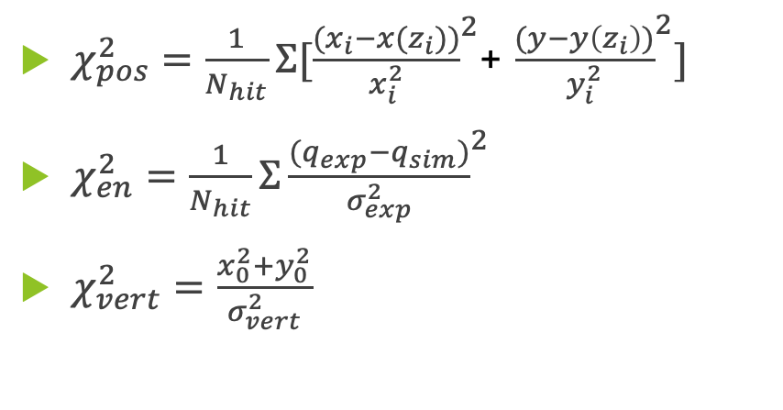
Modifying the objective function
${χ_{}^{2}=χ}_{pos}^{2}$+ $χ_{en}^{2}$+$χ_{vert}^{2}$
The original objective function
The modified objective function
$χ_{pos}^{2}=\frac{1}{N_{hit}}Σ[{\frac{{(x}_{i}−x(z_{i}))}{σ_{pos}^{2}}}^{2}$+ ${\frac{(y−y\left(z_{i}\right))}{σ_{pos}^{2}}}^{2}]$
$χ_{en}^{2}=\frac{1}{N_{hit}}Σ{\frac{∆q^{2}}{σ_{eng}^{2}}}^{}$
$χ_{vert}^{2}=\frac{x_{0}^{2}+y_{0}^{2}}{σ_{vert}^{2}}$
$χ_{pos}^{2}=\frac{1}{N_{hit}}Σ[{\frac{{(x}_{i}−x(z_{i}))}{x_{i}^{2}}}^{2}$+ ${\frac{(y−y\left(z_{i}\right))}{y_{i}^{2}}}^{2}]$
$χ_{en}^{2}=\frac{1}{N_{hit}}Σ{\frac{{{(q}_{exp}−q}_{sim})}{σ_{exp}^{2}}}^{2}$
$χ_{vert}^{2}=\frac{x_{0}^{2}+y_{0}^{2}}{σ_{vert}^{2}}$
Unitless?
Comparable?
Weight too high on position?

Slide 32
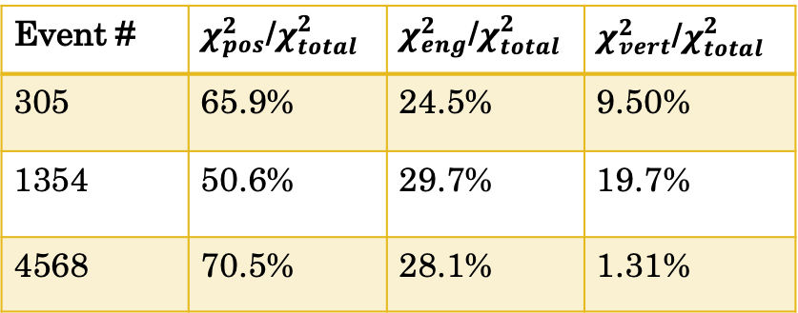
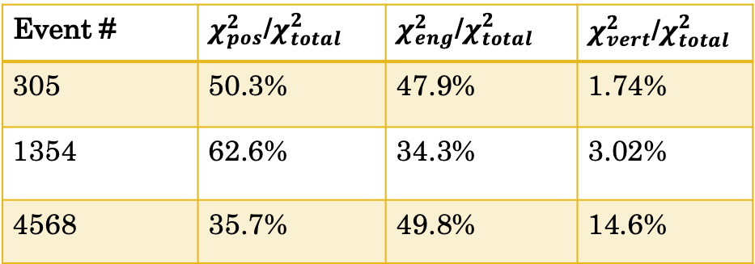
Original objective function
Event # | $χ_{pos}^{2}$/$χ_{total}^{2}$ | $χ_{eng}^{2}$/$χ_{total}^{2}$ | $χ_{vert}^{2}$/$χ_{total}^{2}$
305 | 65.9% | 24.5% | 9.50%
1354 | 50.6% | 29.7% | 19.7%
4568 | 70.5% | 28.1% | 1.31%
Modified objective function
Event # | $χ_{pos}^{2}$/$χ_{total}^{2}$ | $χ_{eng}^{2}$/$χ_{total}^{2}$ | $χ_{vert}^{2}$/$χ_{total}^{2}$
305 | 50.3% | 47.9% | 1.74%
1354 | 62.6% | 34.3% | 3.02%
4568 | 35.7% | 49.8% | 14.6%

Slide 33
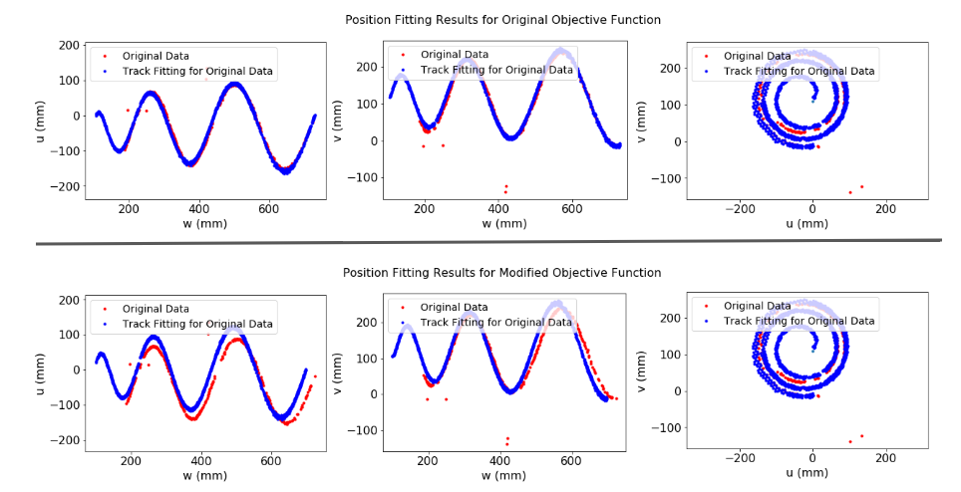

Slide 34
Analysis of Results
All three methods performed significantly better in fitting cleaned tracks
Most accurate: differential evolution
Highest time efficiency: naïve Monte Carlo
Notes:
DE is suitable for fitting single events; MC is suitable for getting a bigger picture of fitting; BH fits in between where it gives better results without reducing a significant amount of time efficiency.

Slide 35
Suggestions for Future Work
Visualization of energy component of the objective function values
Tuning functional parameters
Improving computational efficiency

Slide 36


Acknowledgments
Dr. Michelle Kuchera & Dr. Raghu Ramanujan
ALPhA group @ Davidson
AT-TPC group
https://github.com/ATTPC/pytpc

Slide 37
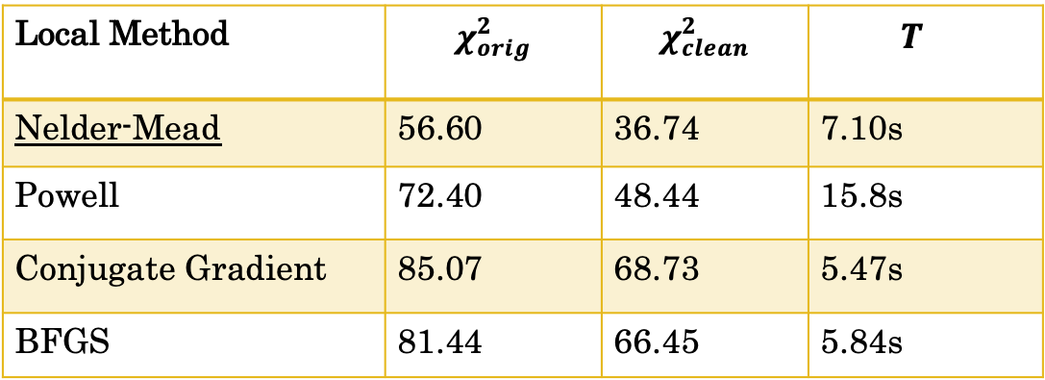
Testing Local Optimization Methods
Local Method | $$χ_{orig}^{2}$$ | $$χ_{clean}^{2}$$ | $$T_{}$$
Nelder-Mead | 56.60 | 36.74 | 7.10s
Powell | 72.40 | 48.44 | 15.8s
Conjugate Gradient | 85.07 | 68.73 | 5.47s
BFGS | 81.44 | 66.45 | 5.84s

Slide 38
